Slide 1
MINOR PROPHETS 1
Hosea, Joel, Amos

Slide 2
MINOR PROPHETS 1
Cycle of Nations
From complacency to apathy
From bondage to spiritual faith
From spiritual faith to great courage
From apathy to dependency
From dependency back into bondage
From courage to liberty
From liberty to abundance
From abundance to selfishness
From selfishness to complacency
Hosea, Joel, Amos

Slide 3
MINOR PROPHETS 1
Hosea 770-722 BC *
North
770 BC
750 BC
730 BC
710 BC
South
* Date approx
Hosea, Joel, Amos

Slide 4
MINOR PROPHETS 1
Hosea = salvation
Hosea, Joel, Amos

Slide 5
MINOR PROPHETS 1
Hosea “wordle”
Hosea, Joel, Amos

Slide 6
MINOR PROPHETS 1
First son ~ 1:4 – Jezreel (God sows)
Daughter ~ 1:6 – Lo -Ruhamah (No mercy)
Second son ~ 1:9 – Lo -Ammi (Not My People)
Hosea, Joel, Amos

Slide 7
MINOR PROPHETS 1
Hosea 770-722 BC *
North
770 BC
750 BC
730 BC
710 BC
South
Joel
770-760 BC *
* Date approx
Hosea, Joel, Amos

Slide 8
MINOR PROPHETS 1
Joel= Jehovah is God
Pethuel = Vision of God
Hosea, Joel, Amos

Slide 9
MINOR PROPHETS 1
Joel “wordle”
Hosea, Joel, Amos

Slide 10
MINOR PROPHETS 1
Andrew Fausset ~ "Joel’s style is pure, smooth, rhythmical, periodic, and regular in its parallelisms; strong as Micah, tender as Jeremiah, vivid as Nathan, and sublime as Isaiah."
Hosea, Joel, Amos

Slide 11
MINOR PROPHETS 1
Chewing locust = Babylonians
Swarming locust = Medo-Persians
Crawling locust = Greeks
Consuming locust = Romans
Hosea, Joel, Amos

Slide 12
MINOR PROPHETS 1
Day of the Lord (5x, 19x in OT) = 1007 years
Hosea, Joel, Amos

Slide 13
MINOR PROPHETS 1
Amos 760-750 BC
Hosea 770-722 BC *
North
770 BC
750 BC
730 BC
710 BC
South
Joel
770-760 BC *
* Date approx
Hosea, Joel, Amos

Slide 14
MINOR PROPHETS 1
Amos = Burden
Hosea, Joel, Amos

Slide 15
MINOR PROPHETS 1
Amos “wordle”
Hosea, Joel, Amos

Slide 16
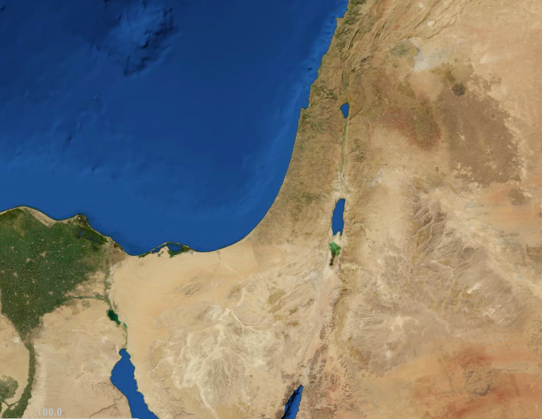
MINOR PROPHETS 1
Israel
Tekoah
Judah
Hosea, Joel, Amos

